Slide 1
RESIDENTIAL HOUSE
PRICE PREDICTION
Presentation For Houses Buyers & Sellers
By
Edward Tong
Shishir Agarwal
Praveen Kasireddy
Josh Jonte
08.05.2020
Notes:
Hi Good afternoon all. My name is Edward and I am joined by my colleagues Shishir, Praveen and Josh today. Our team is going to spend around 15 minutes to present how we use machine learning technique , to predict the residential house price in Iowa. Our target audience is the buyers and sellers who like to buy or sell their house.
I will first start with the problem statement and baseline model result that we have obtained , follow by my colleagues to present different modeling and results that our team have performed and obtained.

Slide 2
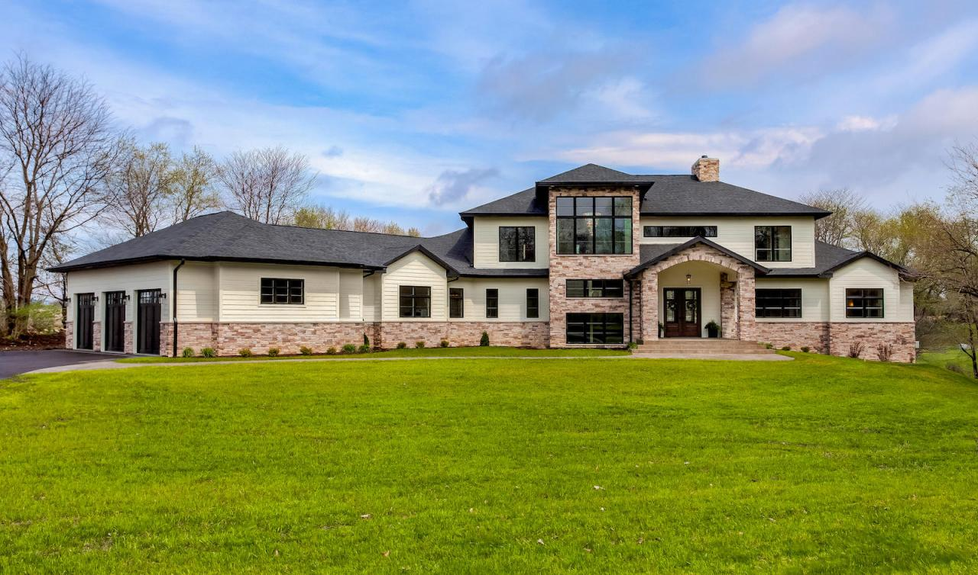
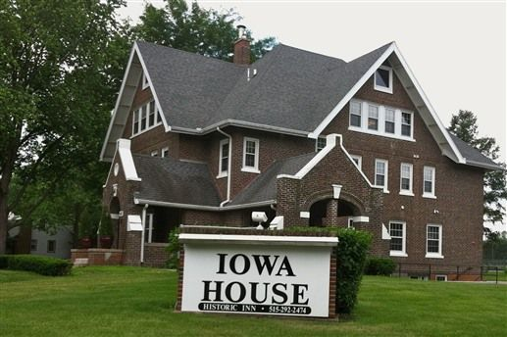
PROBLEM STATEMENT
5M
4M
3M
Sales Price ($)
2M
1M
Factors that Affect Price
Source : https://images.app.goo.gl/APsSNXegkyVrNR4XA
https://images.app.goo.gl/K8MGricnHmCknyFp7
Notes:
Our Problem Statement for this project is :
Use Machine Learning technique to predict the house prices with Kaggle datasets, and the dataset comprises 79 features such as price, locations, areas etc.
As the prices of the houses are continuous and real valued outputs, therefore , we consider this is “Regression” problem.

Slide 3
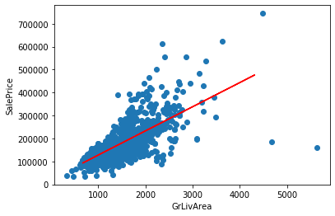
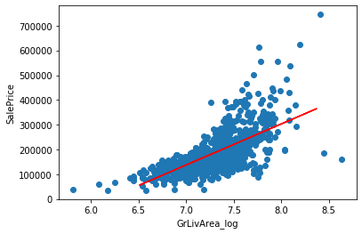
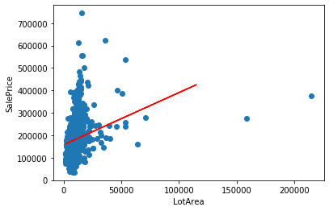
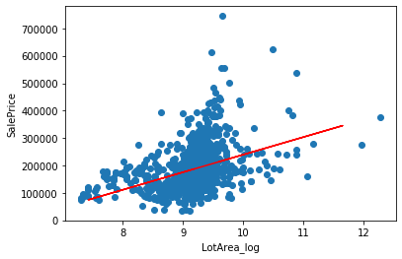
BASELINE MODEL
R^2 - 0.474
R^2 - 0.479
R^2 - 0.083
R^2 - 0.170
Notes:
We started our baseline model with Linear Regression with two selected features which are Above grade (ground) living area(GrLiveArea) and Lot size (Lot Area) , they are both related to house area.
The R -square values that we obtained for the baseline models are all below 0.5.
So we performed more analysis and modeling to improve the prediction accuracy and
next I will hand over to Shishir to walk through some of the improved models that we have done. Thank you

Slide 4
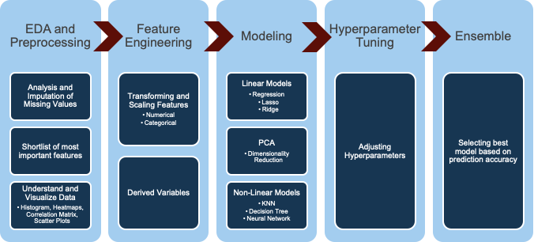
Overall Approach
Notes:
We took the following approach. We divided the project in 5 phases.
We started with EDA and Pre-processing.
We noticed data consisted of numerical and categorical features which will require different type of pre-processing.
First we looked at the null value or missing values in the data. For columns that had more than 10 values missing we removed those columns from the dataset. For columns that had less than 10 missing values we imputed the value. For categorical features we used the most-frequent strategy. For numerical features we used the average.
Second we removed columns that were not relevant for our analysis. For example we removed column named ‘id’ or any variables that were linear combination of other variables.
Third, we visualized the target variable “sales price” through a histogram plot. Because the histogram was skewed we decided to transform “sales price” using lognormal.
Fourth, we also used the correlation matrix to decide which dependent variables are most correlated with the target variables and then chose the top variables with correlation more than 0.5.
Then we moved to Feature Engineering
We performed feature engineering by transforming and scaling the numerical features using StandardScaler and categorical features using onehotencoding.
We also derived a new feature “age of the house” by subtracting YearSold with YearBuilt.
Then we moved to modeling
Then we chose both linear and non-linear models. We experimented with the models with and without PCA.
Then we performed Hyperparameter Tuning and evaluated the model based on R-Square score.
Lastly we selected the best model for predicting the SalePrice

Slide 5
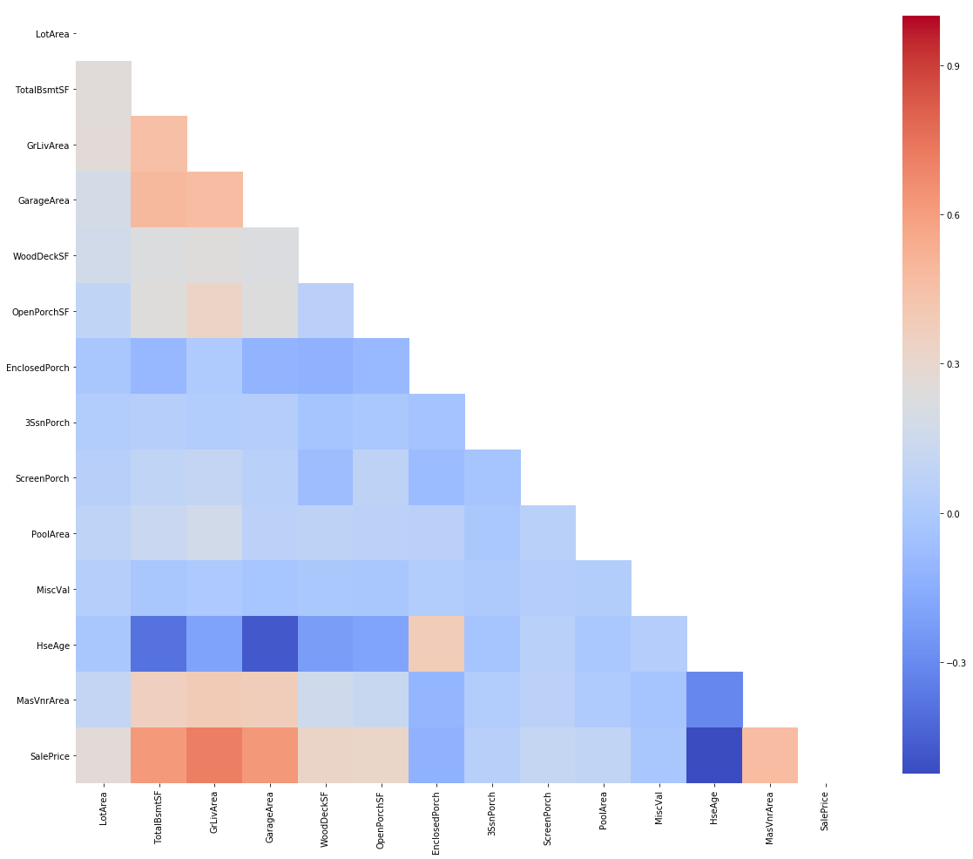
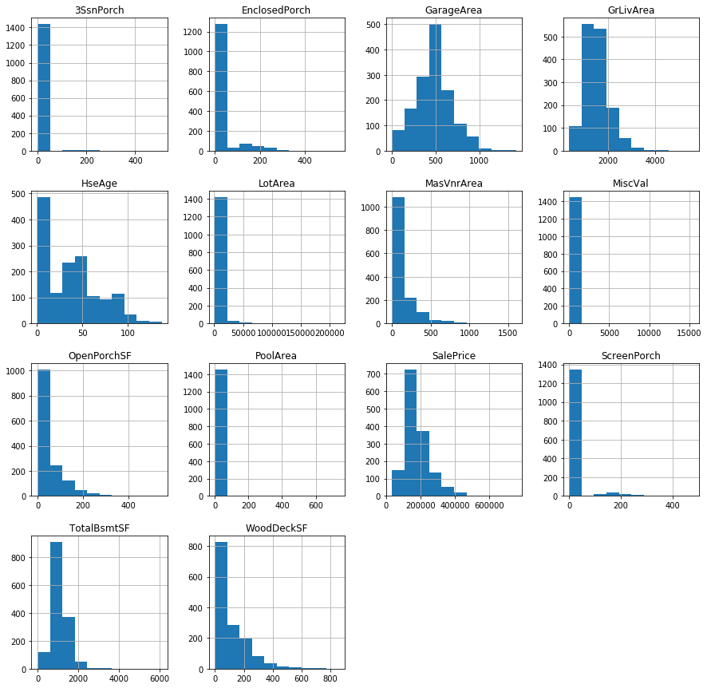
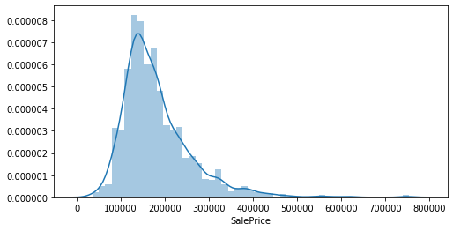
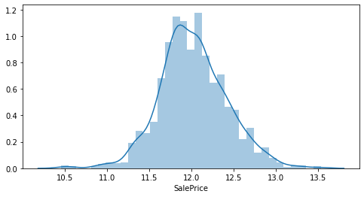
EDA
PoolQC 1453
MiscFeature 1406
Alley 1369
Fence 1179
FireplaceQu 690
LotFrontage 259
GarageCond 81
GarageType 81
GarageYrBlt 81
GarageFinish 81
GarageQual 81
BsmtExposure 38
BsmtFinType2 38
BsmtFinType1 37
BsmtCond 37
BsmtQual 37
MasVnrArea 8
MasVnrType 8
Electrical 1
Utilities 0
dtype: int64

Slide 6
Linear Regression for Predicting SalePrice
Select 4 Numerical and 2 Categorical Features
Independent Variables
Numerical: GarageArea, TotalBsmtSF, HseAge, GrLivArea
Categorical: Neighborhood, SaleCondition
Results
Training Data R-square: 0.823
Develop Data R-square: 0.817
Select 4 Numerical Features and 43 Categorical Features (With PCA)
Independent Variables:
Numerical: GarageArea, TotalBsmtSF, HseAge, GrLivArea
Categorical: OneHotEncoding of 43 variables results into 345 binary variables
PCA: Select first 130 components which accounts for 95% of the variance
Results
Training Data R-square: 0.909
Develop Data R-square: 0.886
Notes:
I will like to cover few details about the linear regression model.
We ran linear regression with and without PCA.
For Linear regression without PCA
We chose the most correlated numerical values as independent variables. Also, we ensured those variables matched our intuition.
Next we chose 2 most relevant categorical value which is location or neighborhood as well as the condition of the house at the time of sale. We used our domain knowledge to choose these 2 variables
We got R-square value between the actual and predicted value of 0.823 on training data and 0.817 on the development data.
For Linear regression with PCA
We chose the same numerical values as before however for the categorical values we assumed we do not have any domain expertise. Instead we took all the categorical data, onehotencoded the data and then performed dimensionality reduction using PCA. We found out 95% of the variance was explained by first 130 PCA components. We added those components to our 4 numerical variables and ran regression. This resulted in R-square value of 0.909 on training data and 0.886 on development data

Slide 7
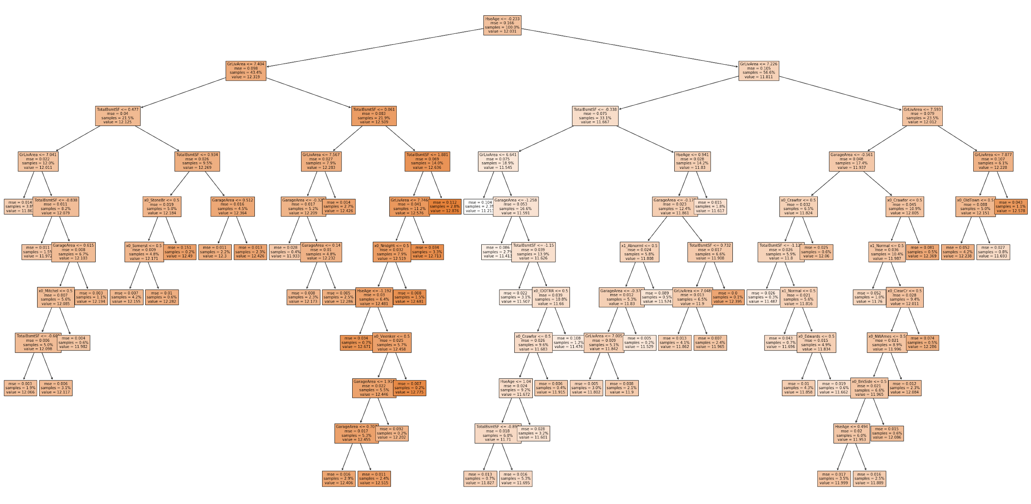
Decision Tree Model
Tree Parameters:
Depth: 10
Number of Features: 35
Min_samples_split: 45
Important Features:
HseAge
GrLivArea
TotalBsmtSF
GarageArea
Results:
Training Data R-square: 0.846
Development R-square: 0.790
Notes:
Continuing with other machine learning models, we tried some non linear models. We ran DecisionTree model so that
We understand the critical features in the data that influence the sales price
also, to keep the model simple and easy to interpret like how we make the decisions using the data in our day to day life.
For DecissionTreeRegression, after tuning different hyper parameters, we concluded to run the model with minimum samples per split as 45 and tree_depth as default.
After training the model and running it on development data, we got the tree with depth of 10 and features like:
HouseAge; GroundLivingArea; TotalBsmtSF; GarageArea etc. in the top levels of the tree
With DecissionTree model, we got the accuracy of 79%.

Slide 8

KNN MODEL
Data:
Features: 134
Model Parameters:
K range =1-10
Best K = 4
Result:
K=4
R-square, Training:0.886
R-square, Development:0.844
Mean Squared Error, Development:0.025
Notes:
Alter the DecissionTree model, we also tried K-Nearest Neighbor model. Here we use the same data we got after the binarization and dimensionality reduction as Shishir explained earlier, which has 134 features.
We ran the K nearest neighbor model to predict the sales price for various Ks and we observed the highest accuracy from model with k as 4, and we got 84.4% accuracy with mean squared error of 0.025.
Josh will continue more …

Slide 9
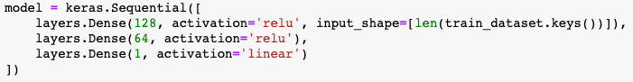
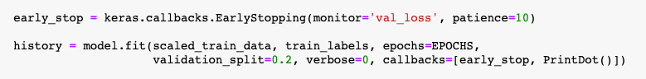
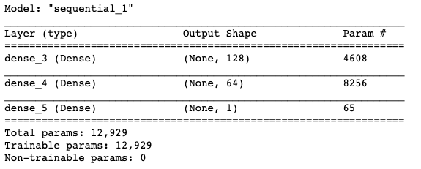
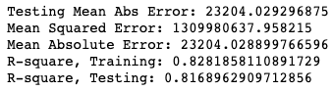
NEURAL NETWORK
1. Create & compile the model
2. Fit the model
3. Evaluate the model
Notes:
For our final model we used a neural network, specifically, we Keras with a TensorFlow backend. A basic neural net was straightforward to create, fit and evaluate as the other model types with a couple of noteworthy differences.
First, we created and compiled the model. The team has not developed the intuition to know how many layers are optimal and the optimal depth of those layers based on the type and shape of the training data, so we used just a basic network with three layers with a total of 12,929 parameters. We used mean squared error as our loss function and ADAM as our optimizer. Keras handles the validation data splitting internally, which we thought was pretty cool.
Next, we fitted the model. During the fitting you can pass a callback method, this callback gets called on every epoch. I found this early stop callback which causes the fitting to stop if the validation loss starts to increase, waiting for 10 epochs before stopping.
After we fit the model, you evaluated it’s r-squared against the validation data, which came out to be 0.817.

Slide 10
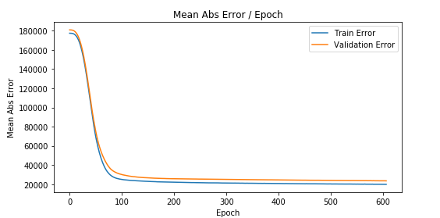
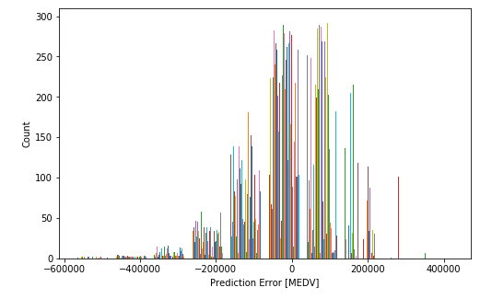
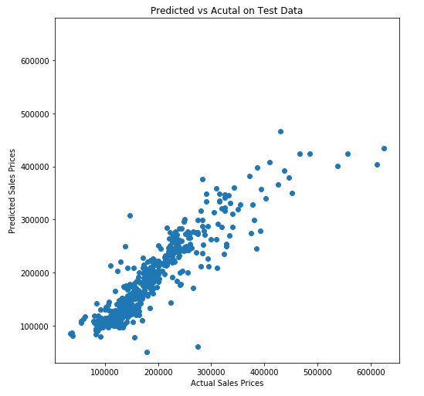
VISUALIZING NEURAL NETWORK RESULTS
Absolute Error / Epoch
Model Accuracy
Error Histogram
Notes:
You can see in this first graph the mean absolute error drops dramatically until 90 or so and then slowly tapers.
The model accuracy is pretty good for homes less than $400,000, but then takes a nosedive - there must be other factors at play once you hit a certain price point.
As you can see, the errors are normally distributed, which is what we had hoped for.

Slide 11
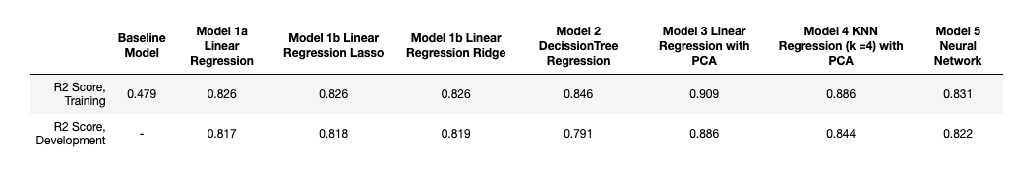
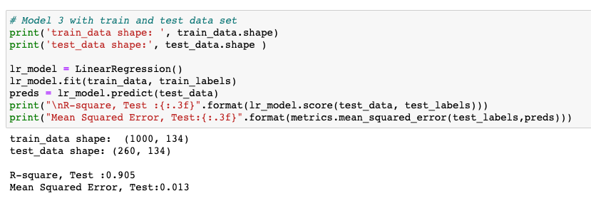
CONCLUSIONS AND FINDINGS
Notes:
We found that adding PCA to both the Linear Regression and KNN had a positive non-trivial impact on the model’s accuracy. We suspect with more data and further development, the neural network would exceed all the previous models in terms of accuracy.
However, a linear regression with PCA ended up being the most accurate in our project. The accuracy with the test data was 0.905, which we felt was good.

Slide 12
Thank You
Q&A

Slide 13
REFERENCE
https://www.kaggle.com/c/house-prices-advanced-regression-techniques
www.slidescarnival.com/help-use-presentation-template

